Slide 1

Dr SNEHA GURDALE
BANGALORE BAPTIST HOSPITAL

Slide 2
a) Define Maternal Near miss and it’s various etiologies
(4marks )
b) Discuss the work up plan for sudden maternal collapse in Labor .(6 marks )

Slide 3
Definition :-
The World Health Organization defines a maternal near-miss case as "a woman who nearly died but survived a complication that occurred during pregnancy, childbirth or within 42 days of termination of pregnancy”.
Severe acute Maternal Morbidity (SAMM) refers to a life-threatening disorder that can end up in near miss with or without residual morbidity.
Near miss cases and maternal deaths together are referred to as Severe maternal outcome (SMO).
As maternal deaths are relatively rare events, in order to overcome the difficulty in estimation and to track quality of in estimation and to track quality of service delivery, examining near-miss events has the potential to complement the maternal death reviews .

Slide 4
Causes of Near miss
Obstetric Hemorrhage | Postpartum hemorrhage (PPH), abruptio placentae, placenta previa, and ruptured ectopic pregnancy.
Hypertensive Disorders | Severe pre-eclampsia, eclampsia, and HELLP syndrome.
Pregnancy-Related Infections | Puerperal sepsis, septic abortion, or chorioamnionitis
Abortive Outcomes | Complications from unsafe abortions, spontaneous miscarriages, or molar pregnancies
Labor-Related Disorders | Uterine rupture, obstructed labor, or uterine inversion.
Endocrine/Neurological | Diabetic ketoacidosis or status epilepticus.

Slide 5
Causes of Near miss
Severe Anemia | Severe iron-deficiency or megaloblastic anemia (typically Hb <6 g/dL).
Cardiovascular Dysfunction | Peripartum cardiomyopathy, rheumatic heart disease, or congenital heart disease.
Infectious Diseases | Viral pneumonia (e.g., COVID-19, Influenza), Malaria, HIV/AIDS, or Hepatitis E.
Organ System Dysfunction | Acute kidney injury (AKI), hepatic failure (jaundice), and respiratory failure (ARDS)
Others | Anesthesia-related complications or surgical injury (e.g., during C-section),Non anaesthetic intubation,Hysterectomy , Return to operating room,Surgical intervention ,ICU admission ,Blood transfusion.

Slide 6
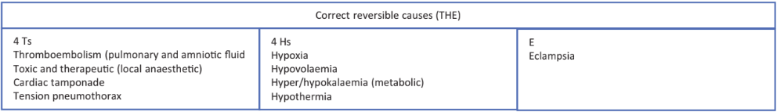
b)Discuss the work up plan for sudden maternal collapse in Labor .(6 marks )
Maternal collapse during labour is a rare but catastrophic obstetric emergency, defined as a sudden, unexpected deterioration in maternal condition resulting in compromised airway, breathing, circulation, or loss of consciousness.

Slide 7
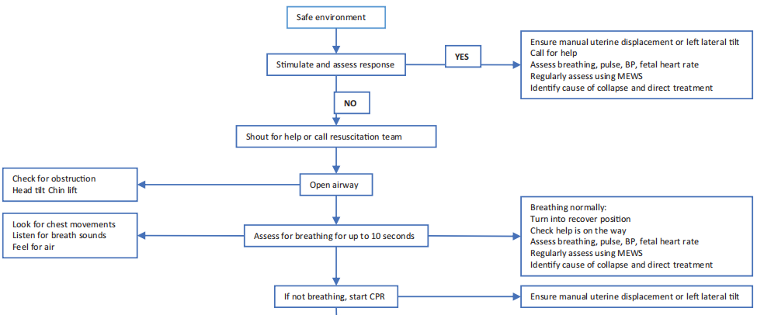
*Maternal Collapse in Pregnancy and the Puerperium (Green-top Guideline No. 56)

Slide 8
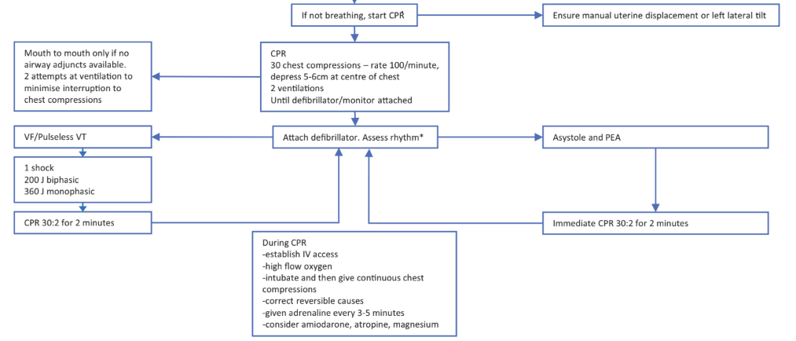

Slide 9
Key Modifications in Pregnancy
Perimortem Caesarean Section (PMCS):
  Indicated ≥ 20 weeks gestation if no return of spontaneous circulation within 4 minutes.
  Target delivery within 5 minutes of cardiac arrest to improve maternal resuscitation outcomes.
  Recommended incision: midline vertical or suprapubic transverse for rapid access..
  Expedite the second stage of labor to hasten delivery when birth is imminent
  Airway Considerations:
  Pregnancy increases risk of difficult intubation; involve skilled staff early.
  Supraglottic devices may be used if intubation fails.
  Protect airway from aspiration, maintain oxygenation, and avoid delaying chest compressions.
Condition-Specific Protocols
Obstetric hemorrhage | Pre-eclampsia | Amniotic Fluid Embolism (AFE) | Anaphylaxis
The Fetus and placenta should be delivered promptly In Massive placental abruption, cesarean section-even if the Fetus is dead for rapid control of hemorrhage Arrange blood products for massive blood transfusion wherever anticipated. Plan for Cesarean hysterectomy in case of Placenta accreta spect | Start IV Antihypertensives immediately as indicated with Seizure prophylaxis with MgSO4 simultaneously, Termination of pregnancy if Persistent high BP recordings. | Supportive: oxygenation, inotropic cardiovascular . Blood product replacement for DIC. Immediate ICU care for invasive monitorig. | IM adrenaline 500 mcg every 5 minutes if needed. IV fluids and monitoring; antihistamines and corticosteroids secondary. Observe post-event for 6–12 hours and plan follow-up.

Slide 10
Local Anaesthetic Toxicity
Stop drug infusion.
Administer IV lipid emulsion (Intralipid 20%) as per establi
Continue ALS/CPR until circulation restored.
2. High/Total Spinal Block
100% oxygen; elevate legs; do not use head-down tilt.
Treat bradycardia and hypotension with atropine or vasopressor
Post-Resuscitation
Transfer to ICU/HDU-monitor and support airway, ventilation, and circulation.
Continue secondary obstetric survey: history, full physical exam, imaging as needed.
Completion of surgery in OT if Return of circulation spontaneously
Documentation & Governance
Allocate a scribe for continuous notes.
Complete clinical incident reporting forms.
Multidisciplinary review afterward.

Slide 11
References
https://www.rcog.org.uk/guidance/browse-all-guidance/green-top-guidelines/maternal-collapse-in-pregnancy-and-the-puerperium-green-top-guideline-no-56/
Adisasmita, Asri; et al. (2008). "Obstetric near miss and deaths in public and private hospitals in Indonesia". BMC Pregnancy and Childbirth. 8 (10): 10. doi:10.1186/1471-2393-8-10. PMC 2311270. PMID 18366625.
Minkauskiene, Meile (n.d.). "Incidence/prevalence of severe maternal morbidity - a literature review. Review prepared for the 12th Postgraduate Course in Reproductive Medicine and Biology, WHO, Geneva, Switzerland". Geneva Foundation for Medical Education and Research. Retrieved 10 Feb 2009.

Slide 12
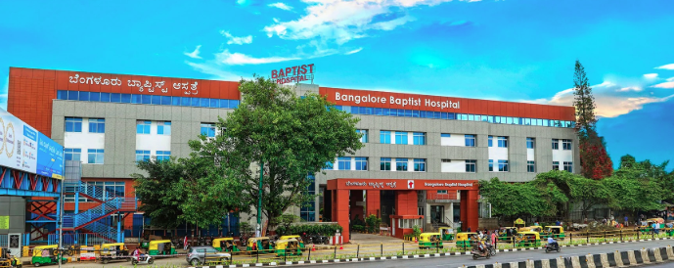
THANK YOU

