Slide 1
CASE PRESENTATION
Dr Sushma Nagarajan
Dr Afreen

Slide 2
Introduction
Mrs.X ,32 years old ,homemaker from Doddaballapur belonging to Socioeconomic class 4(lower middle ) according to Kuppuswamy classification
Booked case at Doddaballapur
G2P1L1 at 9months of gestation
LMP-15.2.2025
EDD-22.11.2025
39 weeks

Slide 3
Presenting complaints
H/o breathlessness and palpitations 1 week back
Referred to teritary care centre as case of newly detected valvular heart disease for safe confinement

Slide 4
History of presenting illness
Regular ANC checkup at Doddaballapur
Complained of breathlessness 1 week back which was progressive in nature and more on accustomed work.
Comfortable at rest
It was associated with palpitations sudden in onset, intermittent, lasting for a few minutes
Aggravated by exertion and relieved by rest

Slide 5
History of presenting illness
No history suggestive of orthopnoea, paroxysmal nocturnal dysnpnoea
No history of undue fatigue ,syncope, chest pain or swelling of lower limbs
No history of epigastric pain , blurring of vision, headache, decreased urine output
No history recurrent episodes of sore throat in childhood
Patient does not give any h/o heart disease or treatment

Slide 6
HISTORY OF PRESENT PREGNANCY
FIRST TRIMESTER
Non consanguineous marriage
Spontaneous conception, UPT positive at 40 days of amenorrhea.
Dating scan done – said to be normal
Booking blood tests were done and said to be normal
Folic acid taken regularly
NT scan done and told to be normal, dual marker not done.
No h/o breathlessness/ palpitation/swelling of lower limbs
No h/o fever with rash, cough, excessive vomiting, spotting or bleeding p/v
No h/o radiation or drug exposure.

Slide 7
2nd TRIMESTER
Quickening felt at 4th month of amenorrhea
Received 2 Doses of Tetanus toxoid injections
Anomaly scan done and told to be normal
GDM screening not done
Iron and calcium tablets were taken regularly
No h/o breathlessness/ palpitation/chest pain
No h/o raised BP/bleeding p/v

Slide 8
THIRD TRIMESTER
Appreciated fetal movements well
Patient was apparently normal till 1 week back had h/o breathlessness and palpitation for which she visited regular ANC hospital- 2d ECHO - RHD with Mild to moderate Mitral stenosis
Referred to teritary care centre 1 week prior but patient turned up late
No history of bleeding /Leaking PV
Admitted for safe confinement
2D Echo on admission- RHD with Mild to moderate Mitral stenosis,dilated left atrium , No RWMA at rest , EF 60 %, adequate LVSF ,Thickened and calcified Mitral valve

Slide 9
MENSTRUAL HISTORY
Attained menarche at 13 years
Regular menstrual cycles with normal flow 3-4/30 days cycle
No h/o dysmenorrhea
LMP-15/2/2025
MARITAL HISTORY
Married for 5 year, non consanguineous marriage

Slide 10
OBSTETRICS HISTORY
G2P1L1
First pregnancy
Natural conception
Booked and immunized
Antenatal uneventful
Vaginal delivery /Boy baby /3years/ 3kg /Alive and healthy
Postpartum period uneventful
Breast fed for 6 months
Barrier methods for contraception

Slide 11
MEDICAL HISTORY
No history of recurrent episodes of fever associated with joint pain, sore throat in the childhood
Not a known case of Diabetes mellitus, Hypertension, Tuberculosis, Bronchial asthma, Seizure disorders, Thyroid disorders or Cardiovascular disease.
No h/o blood transfusion in the past
SURGICAL HISTORY:
No surgeries in the past

Slide 12
FAMILY HISTORY:
No familial history of heart disease in first or second degree relatives.
PERSONAL HISTORY:
Mixed diet
Sleep not disturbed
Normal appetite
Normal bowel and bladder habits
No addictive habits

Slide 13
SUMMARY
Mrs. X, 32 year old, G2P1L1 at 39 weeks of gestation with acute onset of breathlessness with palpitations one week back with valvular heart disease admitted for safe confinement and further evaluation

Slide 14
GENERAL EXAMINATION
Patient is comfortable at rest.
Moderately built and nourished.
Height : 164cm
Pre-pregnancy weight 62kg, present weight 66kg*
BMI 23.1kg/m²
No pallor, icterus, cyanosis, clubbing, pedal edema or generalized lymphadenopathy
Breast and thyroid normal
Spine and gait normal

Slide 15
VITALS:
Afebrile
Pulse rate-90 bpm, regular rhythm and normal volume, no radio-radial or radio-femoral delay.
All peripheral pulses felt.
No pulse deficit
BP-110/80 mmHg, measured in right upper limb in sitting position.
RR-16/min
JVP not elevated

Slide 16
SYSTEMIC EXAMINATION
Cardiovascular System:
INSPECTION:
No supra sternal/supraclavicular pulsations
Chest move equally with respiration
Apical impulse not visualised
No precordial bulge
No scars or dilated veins seen
No parasternal heave

Slide 17
PALPATION:
All inspection findings were confirmed.
Apical impulse felt at the left 4th intercoastal space 1cm lateral to the mid-clavicular line.
No thrill
AUSCULTATION:
Mitral area- S1 heard loud , a rough rumbling, low pitched, grade 3 mid-diastolic murmur heard
Aortic area-S1,S2 heard no murmur
Pulmonary area -S1,S2 heard no murmur
Tricuspid areas- S1,S2 heard, no murmur

Slide 18
Respiratory system
Bilateral air entry equal
Normal vesicular breath sound heard
No basal crepts

Slide 19
Obstetrics examination
Inspection :
Abdomen longitudinally distended
Linea nigra and striae gravidarum present
Umbilicus everted
No scar /sinuses /visible pulsations
Hernial orifice intact

Slide 20
Palpation
Fundal height height corresponds to 36 weeks
Symphysiofundal height 37 cm
Abdominal girth :96cm
EFW –clinically 3kg
Obstetrics grips
Fundal grip: Broad ,soft , irregular mass felt suggestive of breech
Lateral grip: Uniformly curved resistance is felt on right side suggestive of back; irregular, knobby structures are felt on the left side suggestive of limbs

Slide 21
Palpation
First pelvic grip: Smooth hard globular ballotable mass felt suggestive of head
Second pelvic grip: confirm the finding of first pelvic grip and hands a , suggestive that head not engaged
Liquor appears adequate
Auscultation
FHS 140bpm heard on right spinoumbilical line

Slide 22
DIAGNOSIS
32 years, G2P1L1 at 39 weeks POG with singleton pregnancy in longitudinal lie with cephalic presentation with moderate Mitral stenosis, probably of rheumatic origin in sinus rhythm , NYHA class II, not in cardiac failure admitted for safe confinement and delivery.

Slide 23
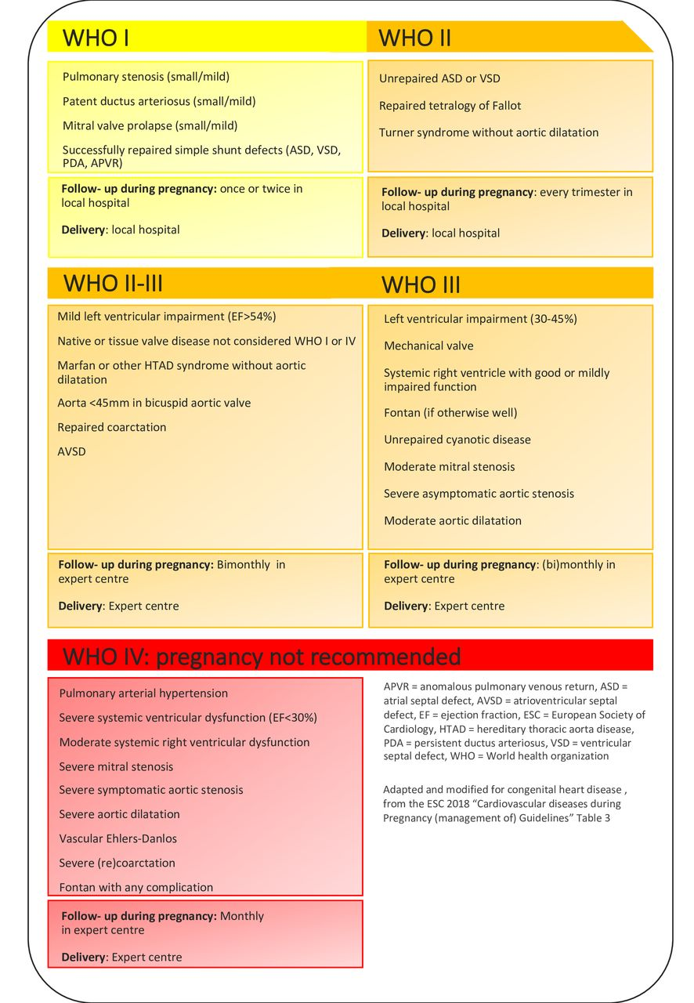

Slide 24
THANK YOU

Slide 25
Course in Hospital
Patient was shifted to the ICU from labour room due to sudden onset desaturation, worsening breathlessness, tachypnea, and tachycardia
she complained of cough with breathlessness and was found to have elevated blood pressure of 150/100 mmHg with bilateral wheeze and basal crepitations on auscultation.
POCUS screening revealed mild LV systolic dysfunction, persistent mitral stenosis, and bilateral B-profile suggestive of pulmonary congestion.
She was started on a furosemide infusion and supportive management continued.
Labour progressed had Vacuum assisted vaginal delivery and Delivered a baby GIRL of 3.44 kg.
Postpartum – Respiratory distress relieved on diuretics, intiated DVT prophylaxis

